Slide 1
Machine Learning
Program Assignment 2
Fall 2020
Instructor: Xiaodong Gu

Slide 2
Goals
Implement A Chatbot Using Deep Learning
achieve high performance
learn to implement popular neural language models such as Transformer, etc.
A presentation to sell your product/idea.
[optional] new ideas for open-domain dialogue generation

Slide 3
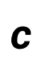
Open-Domain Conversations
A Sample Architecture
I
like
tennis
I
like
football
<s>
I
like
utterance encoder
that
is
cool
$$c$$
context encoder
what
about
you
response decoder

Slide 4
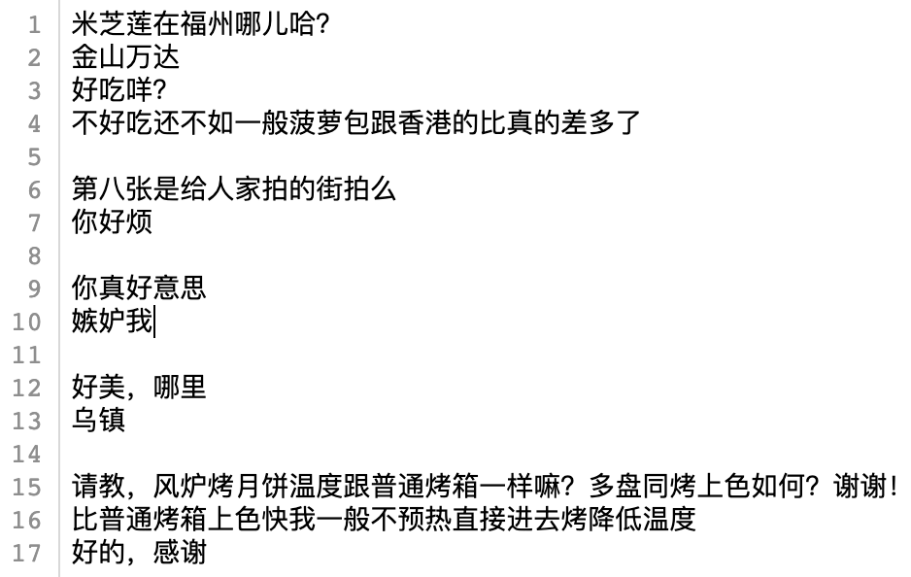
Dataset
We provide a dataset of Chinese chitchat.
Dialog1
Context
Next Utterance
Dialog2
Dialog3
Dialog4
Dialog5
…

Slide 5
Dataset
Download it from Canvas ,
and put the files into a ./data/ folder in your project.
./
data/
train.txt
train.h5
valid.txt
valid.h5
test.h5==valid.h5
proj2.ipynb

Slide 6
Platform
Python notebook by Tencent’s TI-ONE (Recommended)
- Consult in the WeChat group if you have any issues in using the platform.
Python notebook by Anaconda in a local machine
- If you your machine contains a powerful GPU.

Slide 7
A Baseline Implementation
We provide a sample of baseline implementation which is consist of the following sections:
Libraries
Utilities
Configuration
Data Loader
Evaluation
Training Script
Main function for training
Main function for test
You can implement your model in the `Model` section
You can modify some sections except the ‘Evaluation’.

Slide 8
Performance Test
We provide a test script for you to evaluate your model in a pseudo test set (the released test set is just the validation set).
The TA will verify your results using the same script in a real test set.

Slide 9
Requirements and Key Points
Data Preprocessing
We have provided a data loader for the .h5 file
You can adjust the data loader, or design a new one. However, you cannot modify the default test script (the last section of the sample program) as well as the evaluation metrics which the TA will run directly to test your results on a secret test set. So please adapt your code to the test script to avoid mistaken grading.
Model Implementation
Modules you can use:
torch.nn.GRU,. Torch.nn.LSTM, torch.Dataset,
Modules you cannot use:
torch.nn.Transformer, huggineface’s Transformer,…
A direct invocation of third-party libraries for the whole model will receive a significant penalty.

Slide 10
Presentation
A recorded (录好音的) pptx with the following contents:
Without Idea | With New Ideas
Background
Related Works
 | Motivation
Technology | Approach
Implementation Details
Evaluation
Demo
task allocation

Slide 11
Presentation: Background
No strict requirement. You may consider:
Investigate the technical trend of conversation modeling in the industry.
Information you have received about chatbot.
Your understanding about chatbot.
…

Slide 12
Presentation: Related Works
Important technologies (papers) that you have implemented or adopted.
List 2-3 papers and briefly describe the key ideas.

Slide 13
Presentation: Motivation [optional]
If you have an new idea, please show
what is the main problem of existing approaches?
how do you address the problem?
what is the key idea of your model?

Slide 14
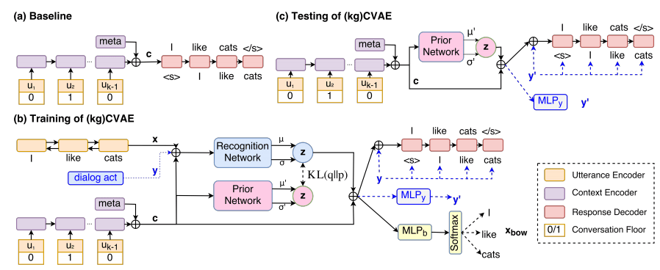
Presentation: Approach
Describe your approach using diagrams and descriptions (like how we introduced the Seq2Seq, Attention, Transformer, etc in the class).
For example:

Slide 15
Presentation: Implementation Details
More details of key components and algorithms (e.g., encoder, decoder, etc) in your implementation.

Slide 16
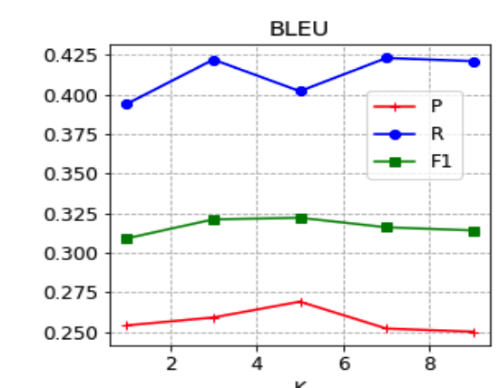
Presentation: Evaluation
Show the following results.
curves of loss and bleu scores in the validation set
comparison of different models (BLEUs) including the provided baseline in the test set.
brief descriptions about the results and comparisons.

Slide 17
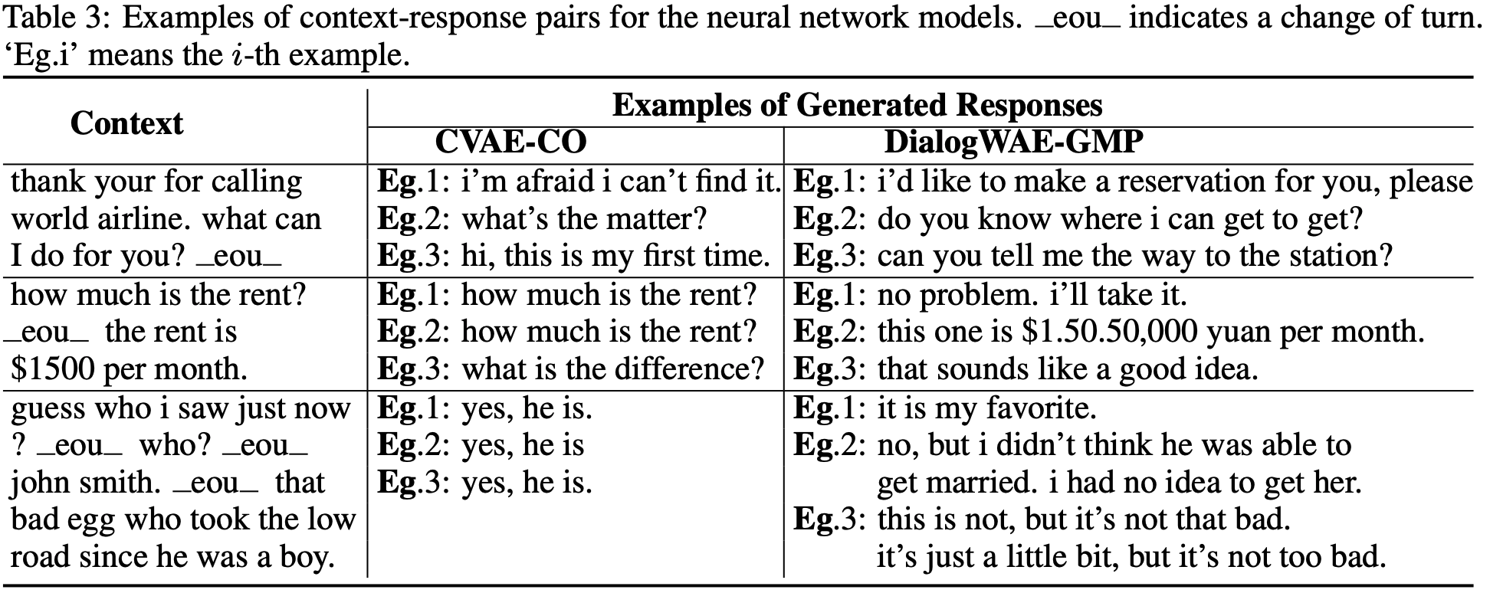
Presentation: Demo
Show some concrete examples (selected context and the generated response) yielded by both yours and the baseline model.
Example

Slide 18
Presentation: Task Allocation
Show the contribution of each member.

Slide 19
Grading Scheme
• Performance [10pt]
• Technical soundness [12pt]
Easy (e.g., no evident improvement, ): 5pt
Medium (e.g., little improvement): 9pt
Advanced ( e.g Transformer): 12pt
• Presentation [8pt]
-
[optional & bonus] new ideas [+10pt]
idea adopted +5pt,
and have shown that it works +5pt
> baseline | 95% baseline | 90% baseline | non-sense results
10pt | 8pt | 6pt | 0pt

Slide 20
Submission
group project (1-3 members)
one of the group member submit a single file named
‘ID1_NAME1_ID2_NAME2_ID3_NAME3.zip’ to Canvas
including:
- code: (proj2.ipynb)
- trained model (checkpoint_itr0.pkl)
- presentation (presentation.pptx with voice)
Due date: Jan. 3rd

Slide 21
Tips
Your programs should be written in such a way that the TA can easily verify the results reported by you.
Your presentation should be clear and comprehensive so that customers (TAs) will buy (give high score to) your product.

